Slide 1

Analysis on
MSc Data Analytics
Business Intelligence and
Business Analytics
2023/2024
X23176725 Bolormaa Mendbayar
X22211420 Akash Narayan Pal
X22198121 Mitali Vilas Sopte

Slide 2
Outline
Business problem
Balanced scorecard
Gap Analysis
Entity Relationship diagram
Dashboard

Slide 3
Business problem
Increase the sales for Sephora implementing visuals
Why do we need to implement visuals?

Slide 4
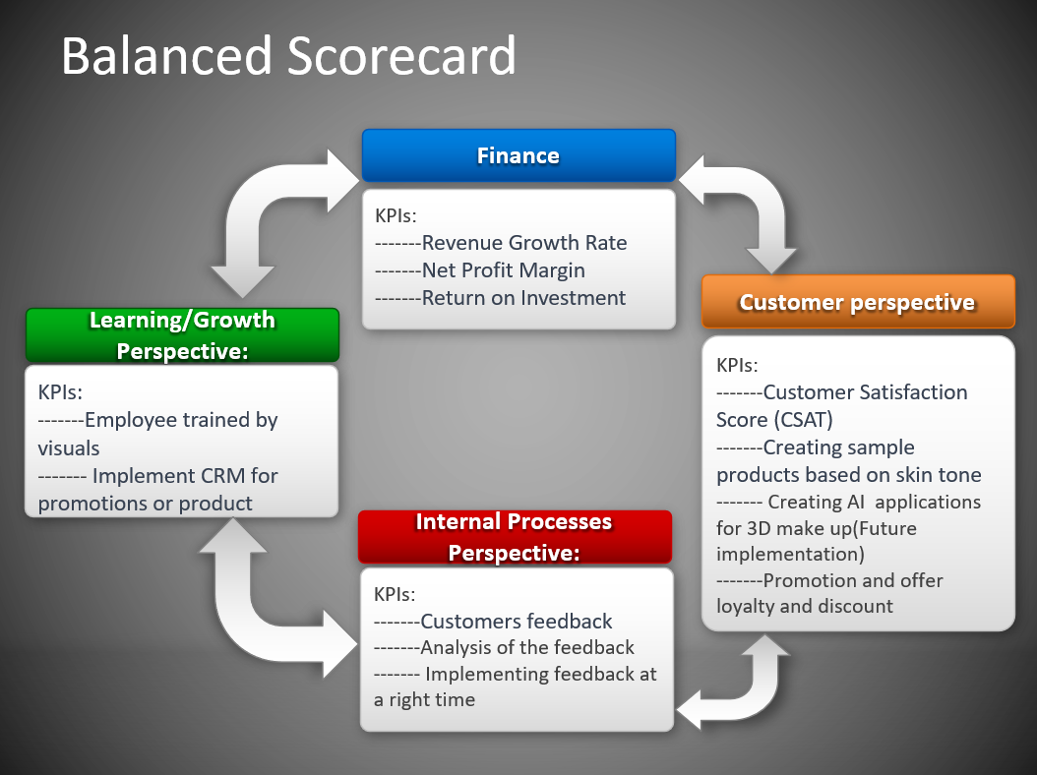
Balanced scorecard

Slide 5
Gap Analysis
GAP Analysis
Current State | Desired Solution | Action items
Ineffective sales tracking results from Sephora Mini's dependence on an old customer database from Sephora. A recent drop in total sales, particularly on weekends, suggests that a new strategy is required. More material is wasted because inventory is arranged according to past internal stocks. Not all staff members are acquainted with the balance sheets that are used for monitoring growth in Sales | Continuous evaluation to improve forecasting integrating dashboards and visualizations. Dashboards showing Cost and Sales Analysis of Products and Brands Improved inventory control by detecting variation in market demand for Sephora mini Products. Future implementation of CRM to promote the Sales by giving promotional offers. | Implementation of Sales Dashboard using Tableau and power BI for visualization of different products and their Brand names. Dashboard showing yearly charts according to the sales. Dashboard for brand analysis with ratings. Dashboard with country wise sales so get the better understand worldwide.

Slide 6
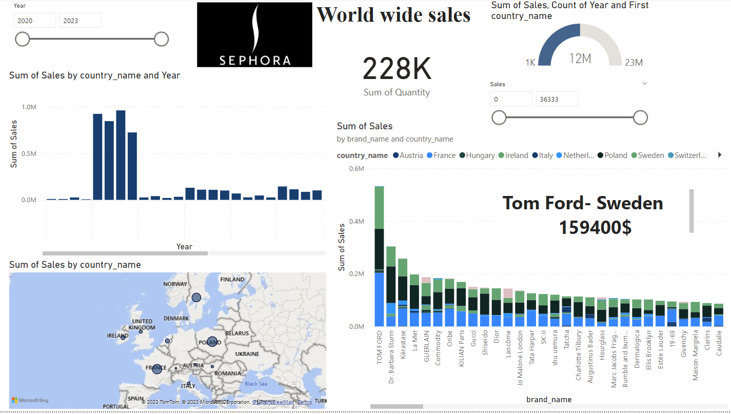
World Wide Sales

Slide 7
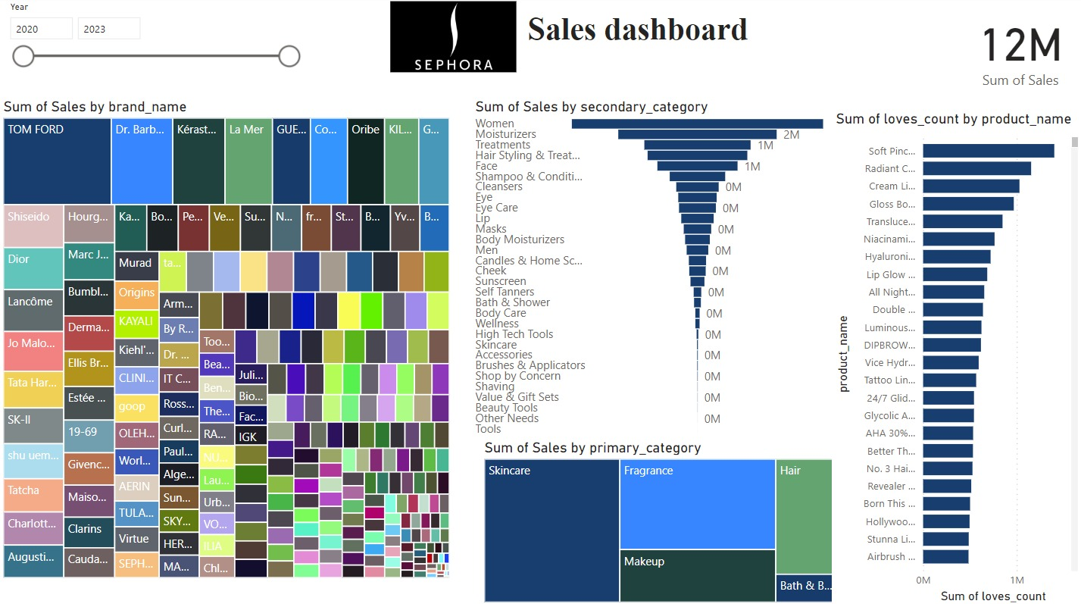
Sales Overall

Slide 8
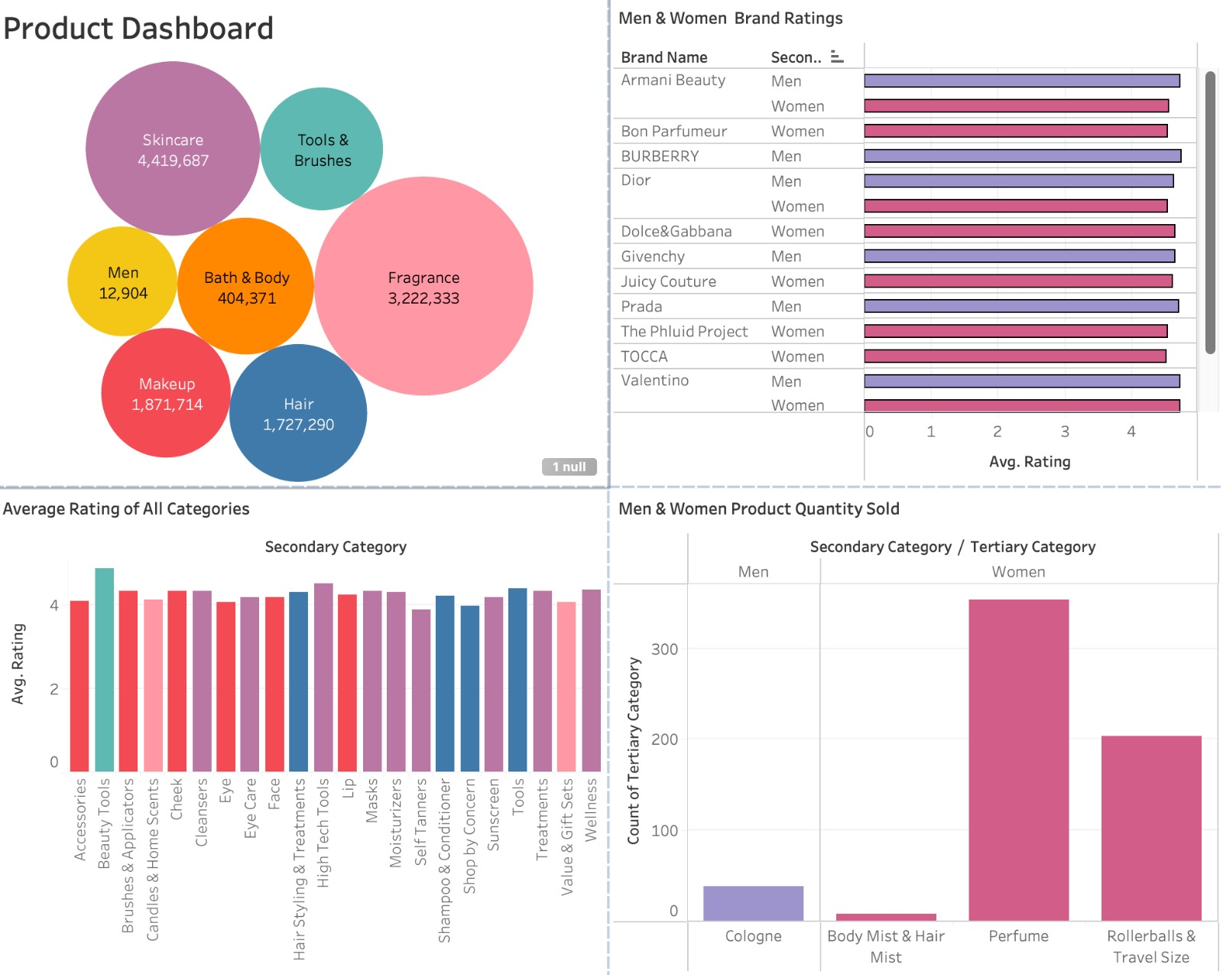
Products

Slide 9
Thank you

